Slide 1
COMMUNITY HELPERS

Slide 2
TEACHER

Slide 3
TEACHER’S
WORKPLACE-
SCHOOL

Slide 4
DOCTOR

Slide 5
NURSE

Slide 6
DOCTOR’S WORKPLACE-
HOSPITAL

Slide 7
ENGINEER

Slide 8
POLICEMAN

Slide 9
POLICE’S WORKPLACE-
POLICE STATION

Slide 10
POSTMAN

Slide 11
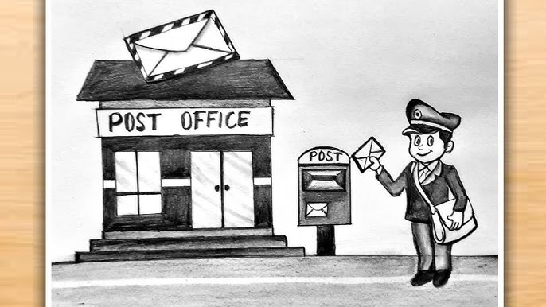
POSTMAN’S WORKPLACE-
POST OFFICE

Slide 12
TAILOR

Slide 13
THANK YOU

